Slide 1
LECTURE # 7
RELATIONS

Slide 2
n-ary Relations and Their Applications
We can have relation between more than just 2 sets
A binary relation involves 2 sets and can be described by a set of pairs
A ternary relation involves 3 sets and can be described by a set of triples
…
An n-ary relation involves n sets and can be described by a set of n-tuples
Relations are used to represent computer databases
.

Slide 3
AN EXAMPLE
n-ary Relations
The domains of the relation are the set of natural numbers
Note: N is the set of natural numbers {0,1,2,3,…}
The relation has degree 3

Slide 4
Relational databases
Relational databases
The relational data model
Database is made up of records.
Typical operations on a database are
find records that satisfy a given criteria
delete records
add records
update records
Database made up of records, they are n-tuples, made up of fields
Student record might look as follows
(name,metricNo,faculty,gpa)
gpa is an attribute
Some everyday databases
student records
health records
tax information
telephone directories
banking records
…
(Jones,200401986,Arts,4.9)
(Lee,200408972,Science,3.6)
(Kuhns,200501728,Humanities,5.0)
(Moore,200308327,Science,5.5)
relations (in relDB) also called tables
Databases may be represented
using the relational model

Slide 5
Relational databases
The relational data model
Example from the book
Attributes: name, metric No, Dept and GPA
primary key:
An attribute/domain/column is a primary key when
the value of this attribute uniquely defines tuples
i.e. no two tuples have the same value for that attribute
Name cannot be a primary key, neither can Dept or GPS
metricNo is a primary key

Slide 6
Relational databases
Selection
Operations on n-ary relations

Slide 7
Relational databases
Join
Operations on n-ary relations
Joins two tables/relations together, matching up on specific attributes

Slide 8
Relational databases
Join
Operations on n-ary relations

Slide 9
Closure
The closure of a relation R with respect to property P is the relation obtained by adding the minimum number of ordered pairs to R to obtain property P.
Reflexive Closure
Theorem
The reﬂexive closure of a relation R on A is obtained by adding (a, a) to R for each a ∈ A.
The reflexive closure of R is R U ∆,
where ∆ = { (a,a) | a ∈ R } is the diagonal relation on A.

Slide 10
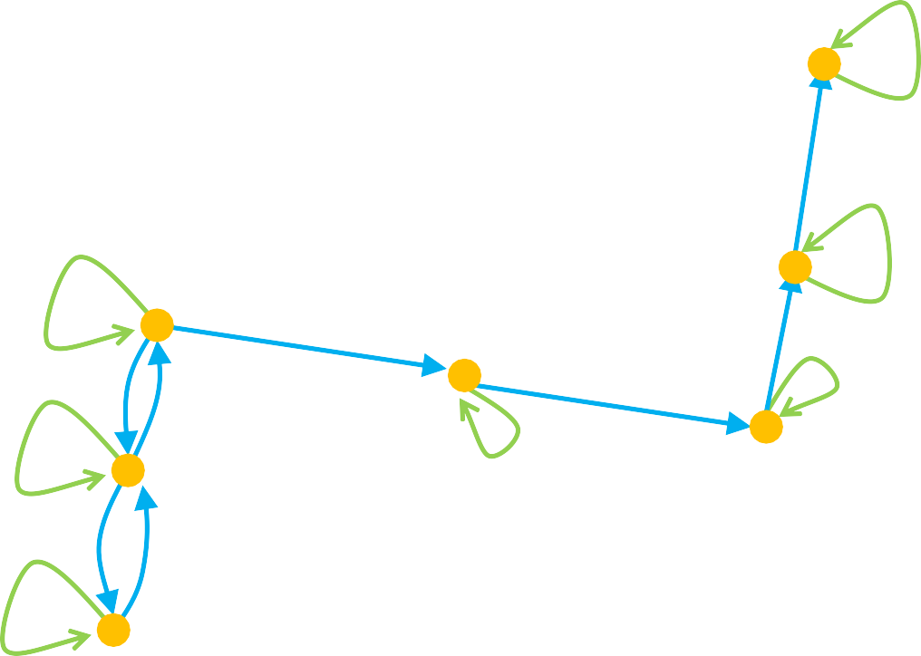
Reflexive Closure
Consider a relation R:
We want to add edges to make the relation reflexive
By adding those edges, we have made a non- reflexive relation R into a reflexive relation
This new relation is called the reflexive closure of R

Slide 11
Symmetric Closure
Definition
Let R be a relation on A. Then R ⁻¹ or the inverse of R is the relation
R ⁻¹ = { < y,x > | < x, y > ∈ R}
NOTE: This relation is sometimes denoted as R^{T} or R^{c} and called the converse of R
Theorem
Let R be a relation on A. The symmetric closure of R, denoted s(R),is the relation R ∪ R⁻¹.

Slide 12
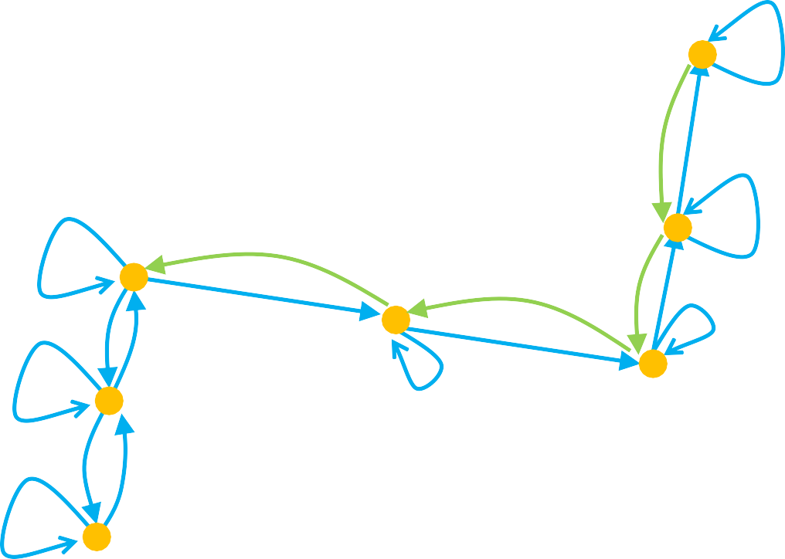
Symmetric Closure
Let’s go back to the previous relation R:
We want to add edges to make the relation symmetric
By adding those edges, we have made a non- symmetric relation R into a symmetric relation
This new relation is called the symmetric closure of R

Slide 13
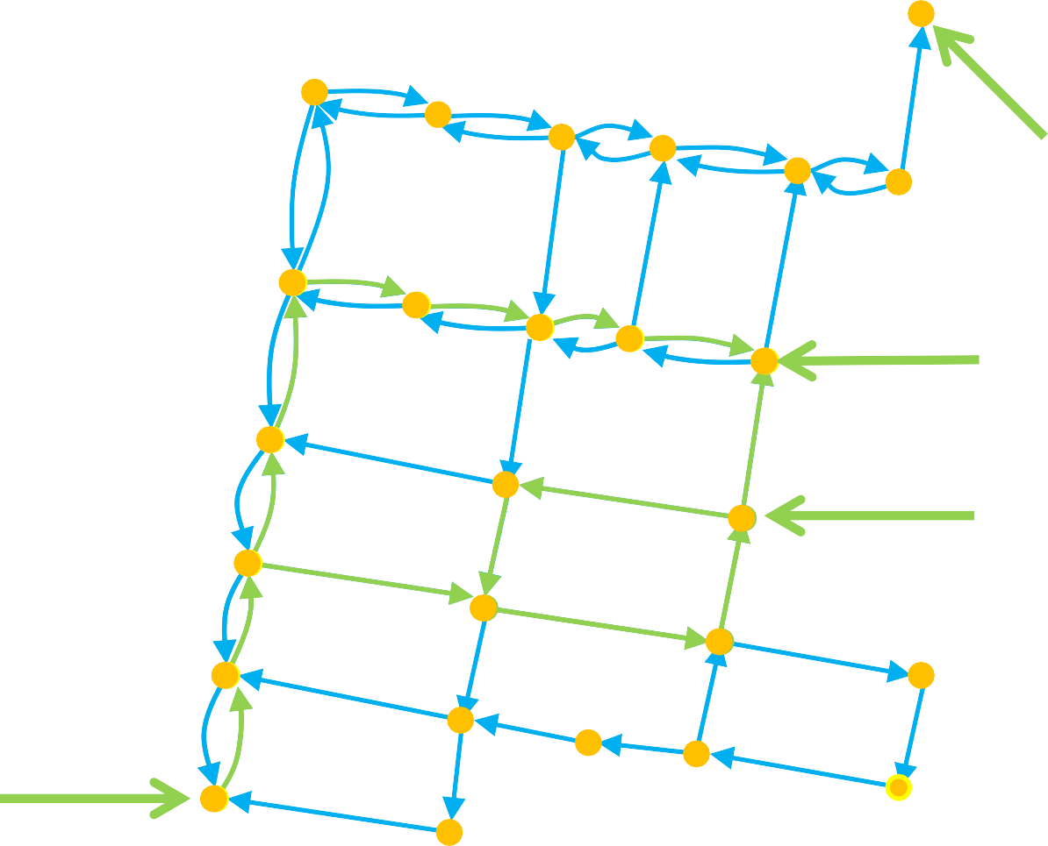
Paths in directed graphs
A path is a sequences of connected edges from vertex a to vertex b
No path exists from
the noted start location
Start (a)
A path that starts and ends at the same vertex is called a circuit or cycle
Must have length ≥1
End (b)
Start (a)
End (b)
Start (a)

Slide 14
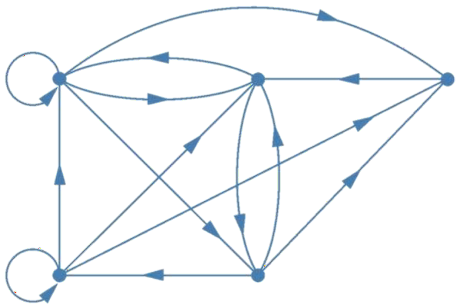




Example
Which of the following are paths in the directed graph shown in the figure: a,b,e,d; a,e,c,d,b; b,a,c,b,a,a,b; d,c; c,b,a; e,b,a,b,a,b,e?
What are the lengths of those that are paths? Which of the paths in this list are circuits?
a
b
c
d
e

Slide 15
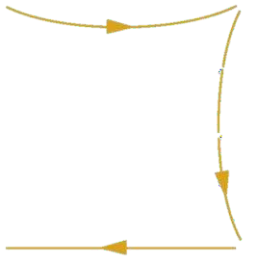
Solution
Which of the following are paths in the directed graph shown in the figure: a,b,e,d; a,e,c,d,b; b,a,c,b,a,a,b; d,c; c,b,a; e,b,a,b,a,b,e?
a
b
c
a,b,e,d is a path of length 3.
d
e

Slide 16



Solution
Which of the following are paths in the directed graph shown in the figure: a,b,e,d; a,e,c,d,b; b,a,c,b,a,a,b; d,c; c,b,a; e,b,a,b,a,b,e?
a
b
c
a,b,e,d is a path of length 3. a,e,c,d,b is not a path.
d
e

Slide 17



Solution
Which of the following are paths in the directed graph shown in the figure: a,b,e,d; a,e,c,d,b; b,a,c,b,a,a,b; d,c; c,b,a; e,b,a,b,a,b,e?
a
b
c
a,b,e,d is a path of length 3. a,e,c,d,b is not a path. b,a,c,b,a,a,b is a path of length 6.
d
e

Slide 18


Solution
Which of the following are paths in the directed graph shown in the figure: a,b,e,d; a,e,c,d,b; b,a,c,b,a,a,b; d,c; c,b,a; e,b,a,b,a,b,e?
a
b
c
a,b,e,d is a path of length 3. a,e,c,d,b is not a path. b,a,c,b,a,a,b is a path of length 6. d,c is a path of length 1.
d
e

Slide 19

Solution
Which of the following are paths in the directed graph shown in the figure: a,b,e,d; a,e,c,d,b; b,a,c,b,a,a,b; d,c; c,b,a; e,b,a,b,a,b,e?
a
b
c
a,b,e,d is a path of length 3. a,e,c,d,b is not a path. b,a,c,b,a,a,b is a path of length 6. d,c is a path of length 1.
c,b,a is a path of length 2.
d
e

Slide 20


Solution
Which of the following are paths in the directed graph shown in the figure: a,b,e,d; a,e,c,d,b; b,a,c,b,a,a,b; d,c; c,b,a; e,b,a,b,a,b,e?
a
b
c
a,b,e,d is a path of length 3. a,e,c,d,b is not a path. b,a,c,b,a,a,b is a path of length 6. d,c is a path of length 1.
c,b,a is a path of length 2. e,b,a,b,a,b,e is a path of length 6.
d
e

Slide 21
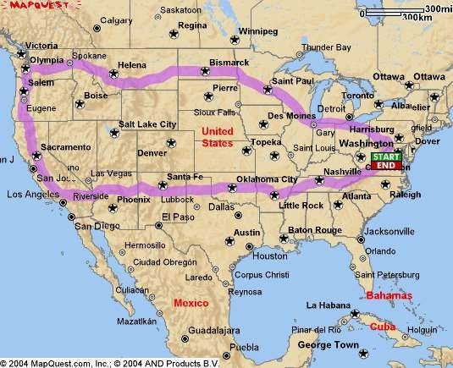
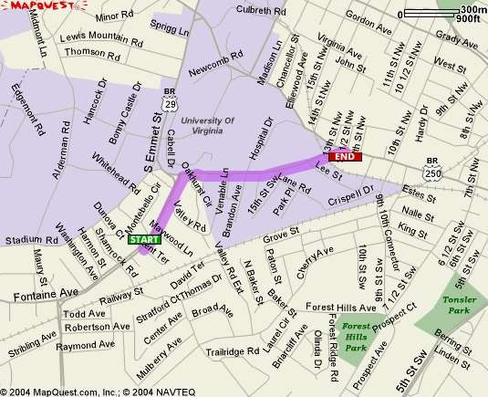
Shortest Path
What is really needed in most
applications is finding the sortest path between two vertices

Slide 22


Transitive Closure
Informal definition: If there is a path from a to b, then there should be an edge from a to b in the transitive closure
First take of a definition:
In order to find the transitive closure of a relation R, we add an edge from a to c, when there are edges from a to b and b to c
But there is a path from 1 to 4 with no edge!
We will study different algorithms for determining the transitive closure
R = { (1,2), (2,3), (3,4) }
(1,2) & (2,3) ∴ (1,3)
(2,3) & (3,4) ∴ (2,4)
4
4
1
1
2
3
2
3

Slide 23

Transitive Closure
Definition
The connectivity relation or the star closure of the relation R, denoted R*, is the set of ordered pairs <a, b> such that there is a path (in R) from a to b:

Slide 24

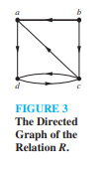


Slide 25

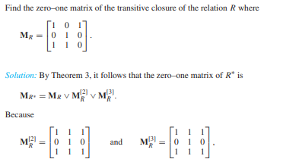
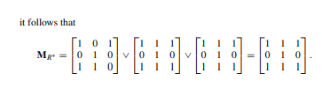

Slide 26
Equivalence
Two elements a and b that are related by an equivalence relation are called equivalent.
The notation a ~ b is often used to denote that a and b are equivalent elements with respect to a particular equivalence relation.

Slide 27
Equivalence Class
Definition 3
Let R be an equivalence relation on a set A. The set of all elements that are related to an element a of A is called the equivalence class of a.
The equivalence class of a with respect to R is denoted by [a]_{R}. When only one relation is under consideration, we can delete the subscript R and write [a] for this equivalence class.

Slide 28
Solution
Given the equivalence relation
R ={(1,1), (1,2), (1,3), (2,1), (2,2),(2,3), (3,1), (3,2), (3,3), (4,4), (5,5)}
on set {1, 2, 3, 4, 5}.
Find [1], [2], [3], [4], and [5].
[1] = {1, 2, 3}
[2] = {1, 2, 3}
[3] = {1, 2, 3}
[4] = {4}
[5] = {5}

Slide 29
Partial Orderings
Definition 1
A relation R on a set S is called a partial ordering or partial order if it is reflexive, antisymmetric, and transitive.
A set S together with a partial ordering R is called a partially ordered set, or poset, and is denoted by (S,R). Members of S are called elements of the poset.

Slide 30
Hasse Diagrams
Start with the directed graph for this relation
Because a partial ordering is reflexive, a loop (a, a) is present at every vertex a. Remove these loops.
Next, remove all edges that must be in the partial ordering because of the presence of other edges and transitivity.
Finally, arrange each edge so that its initial vertex is below its terminal vertex. Remove all the arrows on the directed edges, because all edges point “upward” toward their terminal vertex.

Slide 31
